Slide 1


College Football Analysis
Group 8: Mark, Jenna, Sarah, Raunak

Slide 2
Introduction
Background:
College football captivates millions with its traditions, rivalries, and passionate fan base.
Accessing comprehensive team statistics presents challenges:
Scattered data sources
Acronyms and terminology
Structural changes in the sport
Dataset Overview:
Dataset: College Football Team Stats Seasons 2013 to 2023 (Kaggle).
Over 145 variables per team, including:
Offensive performance.
Defensive efficiency.
Turnover statistics.
Red zone effectiveness.
Enables detailed analysis of trends and success factors in college football.
Notes:
Sarah

Slide 3


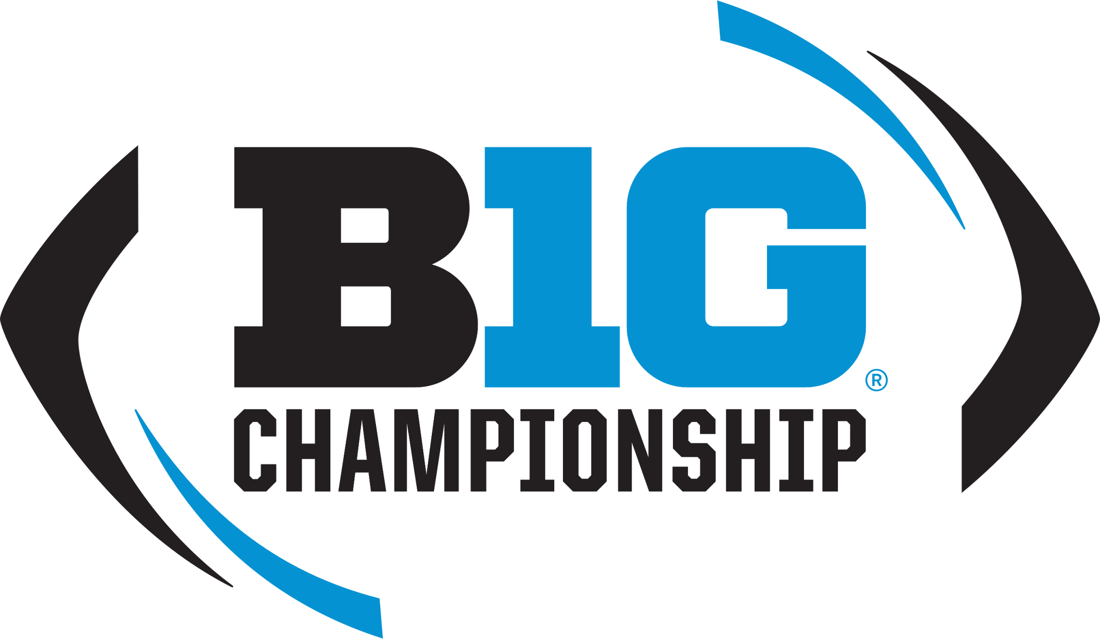
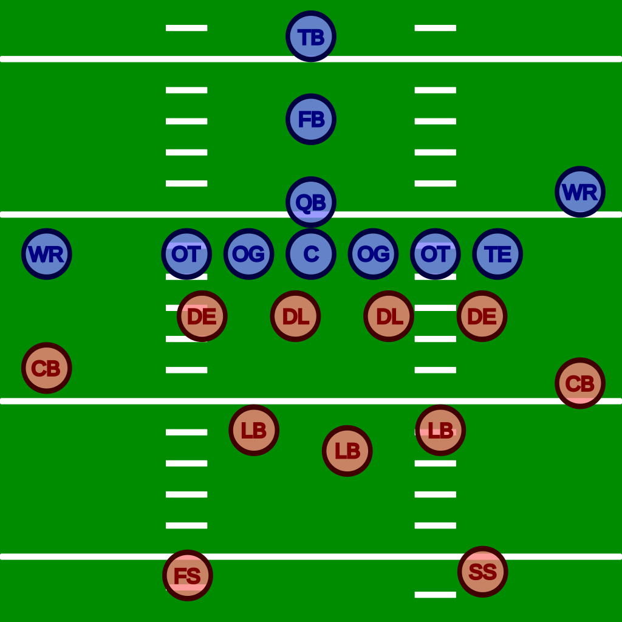
Research Aims & Questions
What features (variables) of a football team predict wins?
Which Collegiate Conference is the “best”?
Does defensive ranking affect win rate?
Notes:
Marl

Slide 4
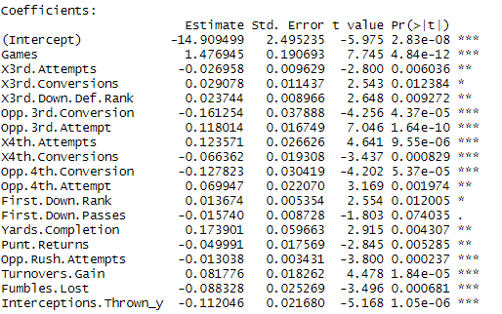
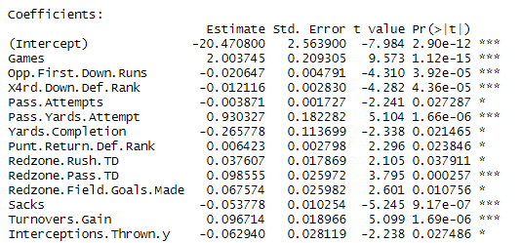
Finding the most predictive features
2023
2013
R^2 = .9514 P-Value < 2.2E-16
R^2 = .9746 P-Value < 2.2e-16
Generalized models of all features after correcting for multicollinearity, categorical variables, and high p-values.
Note: 2018 was performed but was overfitted. Used backwards elimination to reduce model
Notes:
Mark:
Produced final reduced models for 2013 and 2023 by eliminating multi-co, selecting numerics, backwards elimination and manually eliminating high p-values through multiple drafts.
2018 was overfit so not included.
Both had a good fit and low p-value.
# of games wins all.

Slide 5
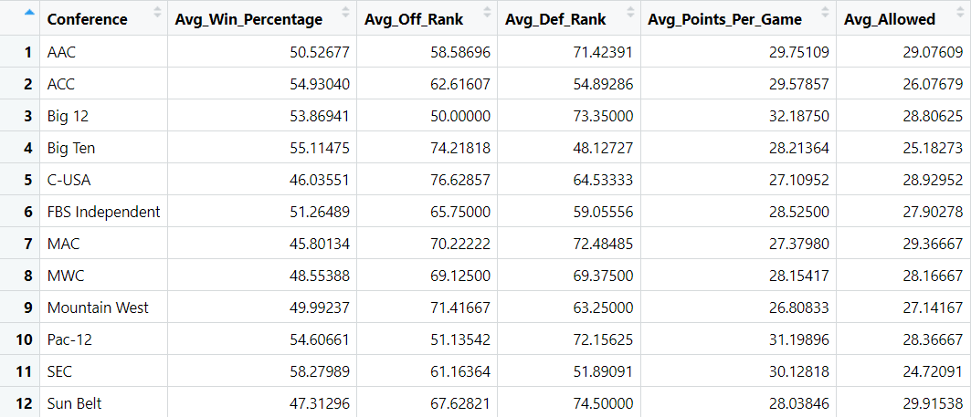
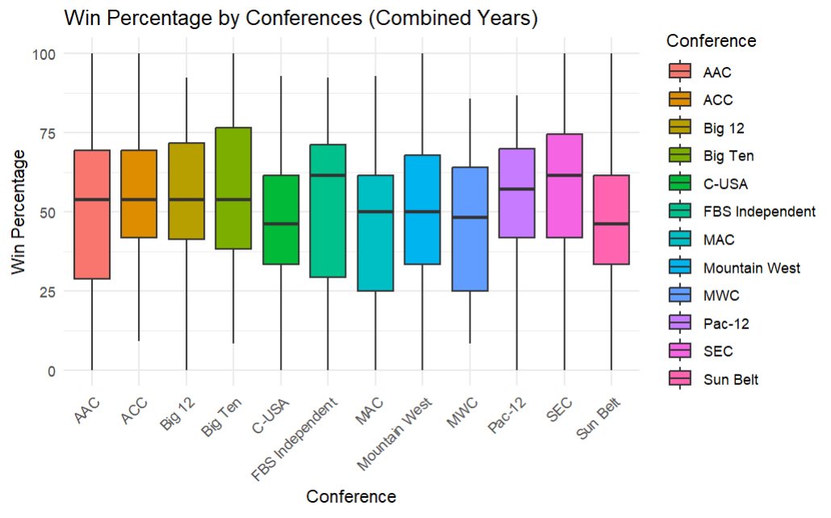
Analyzing CFB Conferences
We used multiple regression with the most correlated variables in order to help determine which collegiate conference is the “best”.
Figure 1: Summary Statistics by Conference for combined years (2013-2020)
Notes:
Jenna

Slide 6
“Best” CFB Conference
Rather than using this to determine the best conference, we chose to weigh our values and compute a concrete number to compare.
Win Percentage: 30%
Off Rank: 20%
Def Rank: 20%
PPG: 15%
Allowed PPG: 15%
Average Win Percentage
Best: SEC (58.28%)
Runner-Up: Big Ten (55.11%)
4. Average Points Scored per Game
Best: Big 12 (32.19)
Runner-Up: Pac-12 (31.20)
2. Average Offensive Rank
Best: Big 12 (50.0)
Runner-Up: Pac-12 (51.14)
5. Average Points Allowed
Best: SEC (24.72)
Runner-Up: Big Ten (25.18)
3. Average Defensive Rank
Best: Big Ten (48.13)
Runner-Up: SEC (51.89)
Results:
SEC: 0.800
Pac-12: 0.546
Big Ten: 0.418
Big 12: 0.350
Notes:
Jenna

Slide 7
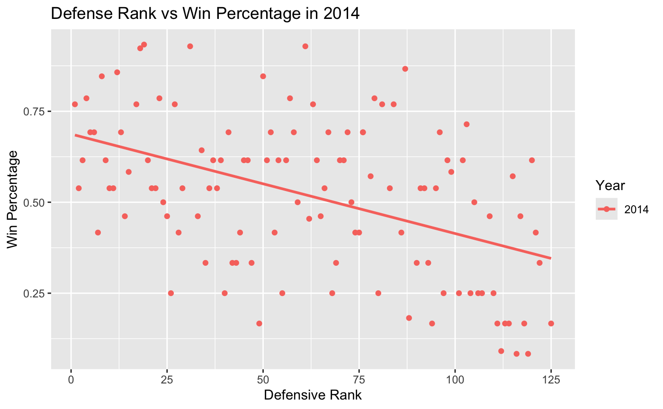
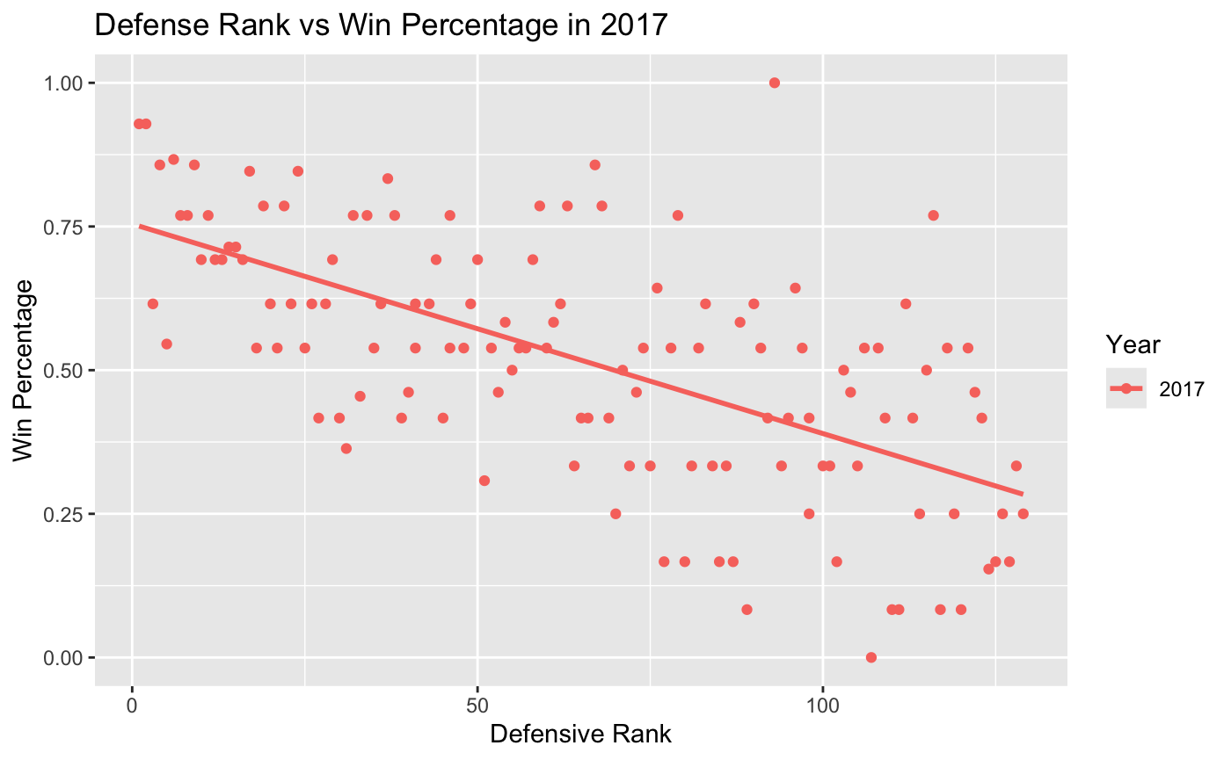
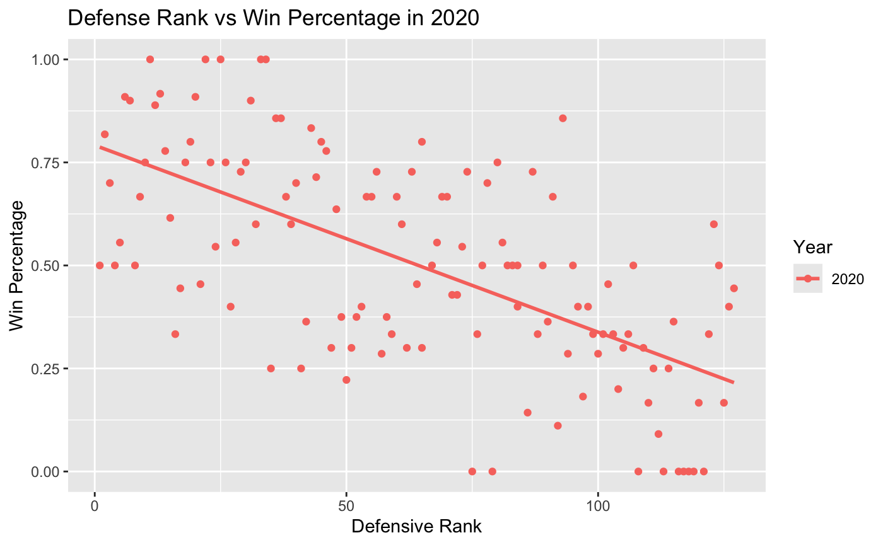
Addressing Defensive Impact on Win-Rate
Comparing Defensive Ranking vs. Win Percentage compared between three different years
Notes:
Raunak

Slide 8



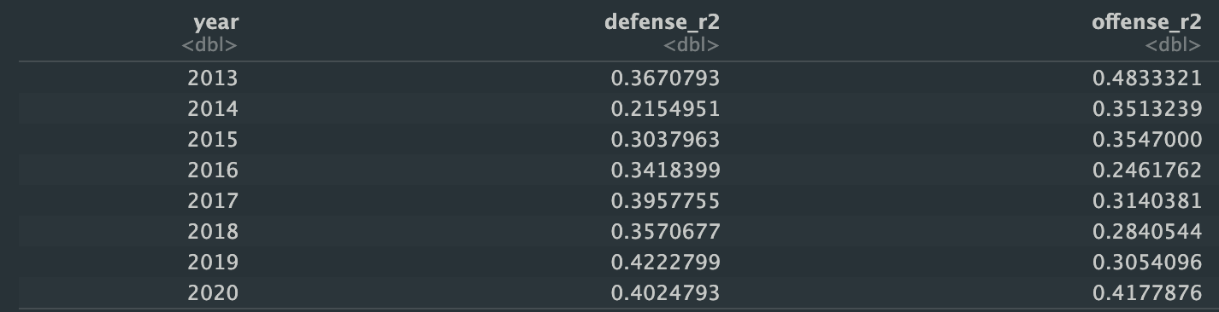
Addressing Defensive Impact on Win %
From the incredibly small p-values we can conclude that defensive ranking does have an effect on win-rate
Comparing the r² values between offense to win-rate and defense to win-rate we see offense has a bit more impact on win rate
Notes:
Raunak

Slide 9
Conclusion: Findings & Future Exploration
Summarised Findings:
What features (variables) of a football team translate into wins?
The number of games was the strongest predictor for number of wins.
Which Collegiate Conference is the “best”?
SEC is the strongest overall based on a combination of win percentage & defensive strength
Pac-12 & Big 10 are in the top 3
Does defense really win championships?
A higher defensive ranking correlates to a higher win rate
Future Exploration
What is the impact of coaching changes on team success?
How does recruitment quality correlate with team performance?
What role does home-field advantage play in determining outcomes?
Notes:
All

Slide 10
Conclusion: Evaluation
More background research may improve feature reduction.
Specifically, identifying why “games” takes the lead.
Did we exclude any important variables?
Include all the years in our 3-question analysis.
Each question was unable to use all of the years (2020-2023) from the dataset.
Sport Changes
Changes in NCAA rules, game-playing styles, and technologies over the decade may have influenced the findings, but were not explicitly accounted for.
Colleges and universities will often change conferences. This happened multiple times from 2013-2023, which is the timeframe in which our data was collected.
Notes:
Mark + Sarah

Slide 11
Thank you for listening!
Notes:
Raunak

Slide 12
References
ESPN. (n.d.). College football conference realignment tracker: 2023 season. Retrieved December 3, 2024, from https://www.espn.com/college-football/story/_/id/35804245/cfb-conference-realignment-tracker-2023
Gallini, J. (2019). College football team stats: Seasons 2013 to 2023 [Dataset]. Kaggle. Retrieved from https://www.kaggle.com/datasets/jeffgallini/college-football-team-stats-2019
GeeksforGeeks. (n.d.). Calculate the interquartile range in R programming – IQR function. Retrieved December 3, 2024, from https://www.geeksforgeeks.org/calculate-the-interquartile-range-in-r-programming-iqr-function/
OpenAI. (2024). ChatGPT (December 3, 2024 version) [Large language model]. Retrieved from https://chat.openai.com
Syracuse New Times. (n.d.). What makes college football an integral part of U.S. culture? Retrieved November 15, 2024, from https://syracusenewtimes.com/what-makes-college-football-an-integral-part-of-us-culture/
Stack Overflow. (n.d.). https://stackoverflow.com

